Slide 1
CS 460 Hand Brake Simulation Code Review
Simulation Software by Team 07
Code Review by Team 09

Slide 2
Presentation Organization
Review the code line by line
Test the code using new test cases developed
Make sure that changing test cases is a smooth operation
Make sure that all the logical interfaces from the SRS can be coded
Demonstration
Initial Test
EBS Engagement

Slide 3
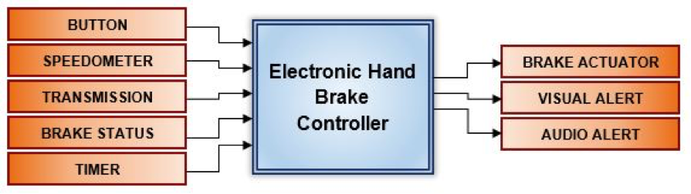
SRS Logical Interface Diagram
*Team 02 SRS

Slide 4
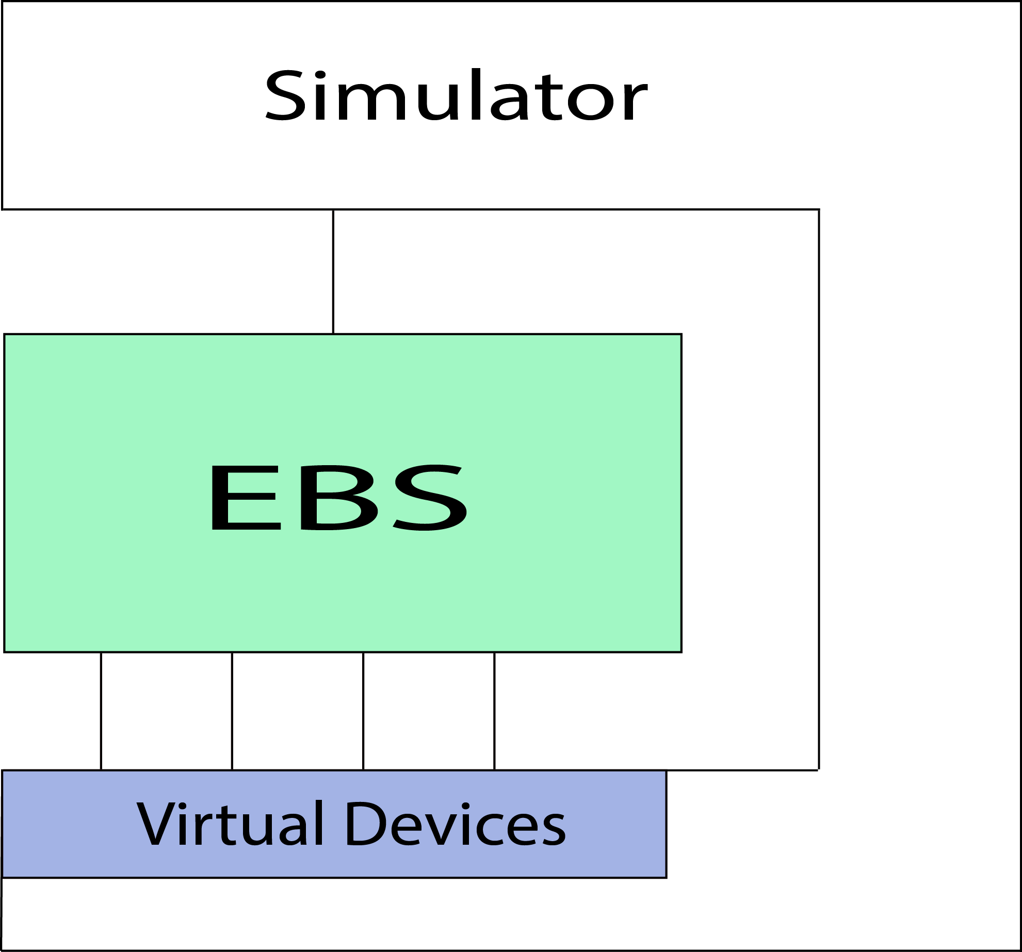
Simulator Architecture Overview
*Per Roman

Slide 5
Appendix: External Interfaces
Simulator
public void update() – This is the method that invokes the EBS. Simulator will call update() every 1/60th of a second.
BrakeButton
public Position getPosition() - returns the current position of the button. Position is an enum consisting of states {UP, DOWN}
AlarmNotification
public void playSound(AudioClip sound) - Play a sound from the Button, indicating the status of the brake system.
BrakeController
public void applyForce(Double pressure) - Apply a force of magnitude
public Status getBrakeStatus() – return the current status of the Emergency Brake. Status is an enum consisting of states {FULLY_ENGAGED, NOT_FULLY_ENGAGED, DISENGAGED}.
(pressure*MAX_Pressure) to the Emergency Brake. pressure is a real number in range [0,1]
VehicleElectronics
public double getSpeed() - returns the current x-velocity of the car in meters per second.
public gear getGear() - returns an enum with values {PARKED, NEUTRAL, DRIVE, REVERSE}.
LEDNotification
public void Light(Color color) - Set the color of the EBS Button LED. Color is an enum with values {RED,ORANGE,BLUE}.

Slide 6
Discussion of Simulation Interfaces
Logical Interface
Simulation Class
Button
Speedometer
Transmission
Brake Status
Brake Actuator
Visual Alert
Audio Alert
Timer
BrakeButton
VehicleElectronics
VehicleElectronics
BrakeController
BrakeController
LEDNotification
AlarmNotification
Main.update()
*Logical Interfaces from SRS diagram
*See Java Doc class method documentation for more information on simulation classes

Slide 7
Resource Appendix
Updated Simulation Code
https://github.com/MathewMcPheeters/BrakeSim.git
Java Doc
http://www.cs.unm.edu/~mmcpheeters/cs460/
EBS Class Template
/nfs/student/mmcpheeters/Public/EBS.java

